Slide 1
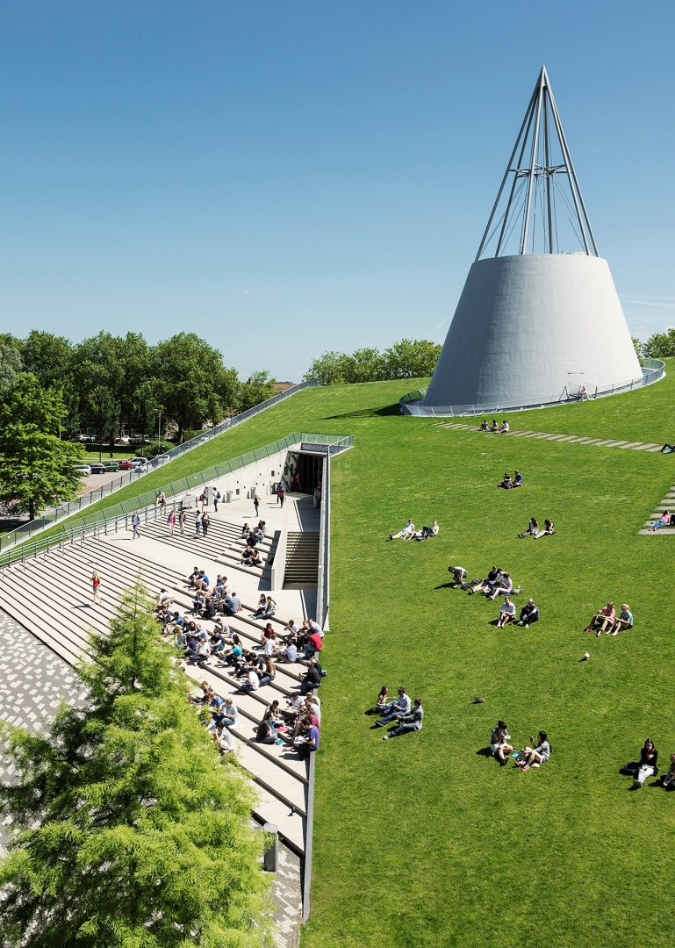
Title slide + image
AE4422-20 Agent based modelling
Scope of assignment

Slide 2
Content
Research question
Scope\assumptions
Agents
Environment

Slide 3
Quote
How can an airport utilising taxibots for sustainable taxiing operations, be modeled by a multi-agent
based modelling approach?

Slide 4
Scope/assumptions
We focus on fully automated airport movements (taxiing) so no ATC is present We focus only on the movement of aircraft and taxiing bots When the aircraft and taxibot are connected the speed is constant and the steering/stopping is decided by the aircraft The airport layout is modeled by a directed graph a set of connected taxiways runways and gates All taxiways can be traversed in both directions The airport only has one departure and one arrival runway Departing aircraft only move from gate to the departure runway and arriving aircraft only move from the arrival runway to the gate Departing aircraft disappear from the model at the departure runway and arriving aircraft appear at the arrival runway When an aircraft arrives at the arrival runway a taxibot should be ready to pick up Agents have global awareness of the positions of the other agents
Weather is not considered Infrastructure is always available Taxibots aircraft performance availability are always constant and reliable No other vehicles are considered on the airport No turn around operations are considered All gates are for one aircraft no double gates

Slide 5
Agents
Aircraft:
Is an agent because it decides, during the taxiing, where to go and when to stop
Taxibots:
Is an agent because it decides, during movements between pick-ups, where to go

Slide 6
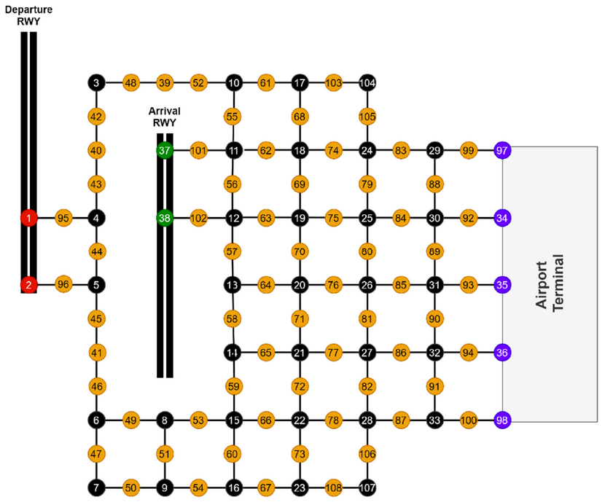
Environment
Two runways, one for departure, one for arrival
Nodes at every crossing of taxiways
5 gates

